Slide 1
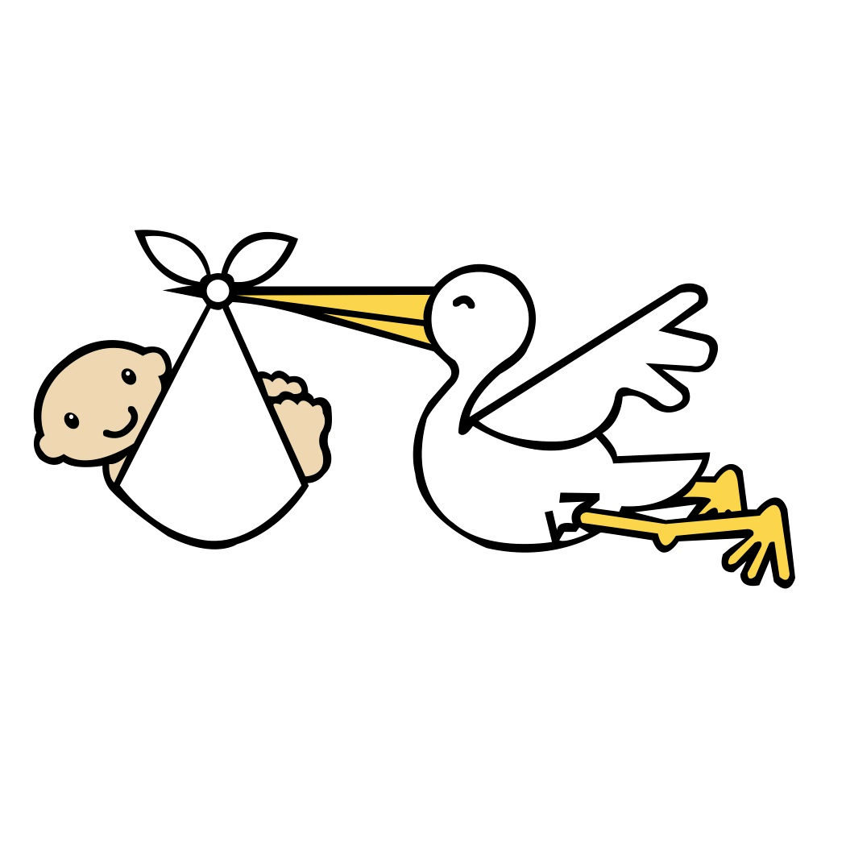
Cancer
Lesson 2.2
How is replication controlled in a normal cell and disrupted in cancer?

Slide 2
Do Now
What is the purpose of mitosis?
When do we need our cells to undergo mitosis?
If a cell divides once every day, how long does mitosis last?
1 hour
6 hours
12 hours

Slide 3
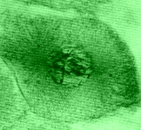
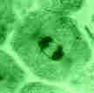
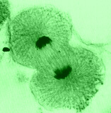
Mitosis
Prophase
1 hour
M

Or it may not be undergoing mitosis any more.
Metaphase
What’s happening when
the cell isn’t in mitosis?
Anaphase
It is preparing for the next mitosis.
Cells spend most of
their life here
Telophase

Slide 4
How do cells know when to start or stop mitosis?
Instruction come from signals either outside the cell
(their environment), or within the cell-
Start signals:
Plenty of nutrients
Pro-growth factors secreted by other cells
Stop signals:
Lack of nutrients can be caused by cell crowding.
Anti-growth (inhibitory) factors secreted by other cells
Damage within the cell.

Slide 5
The signals work on a set of molecules in the nucleus called the “cell cycle clock”
Signals from the environment
Don’t divide
Divide

Slide 6
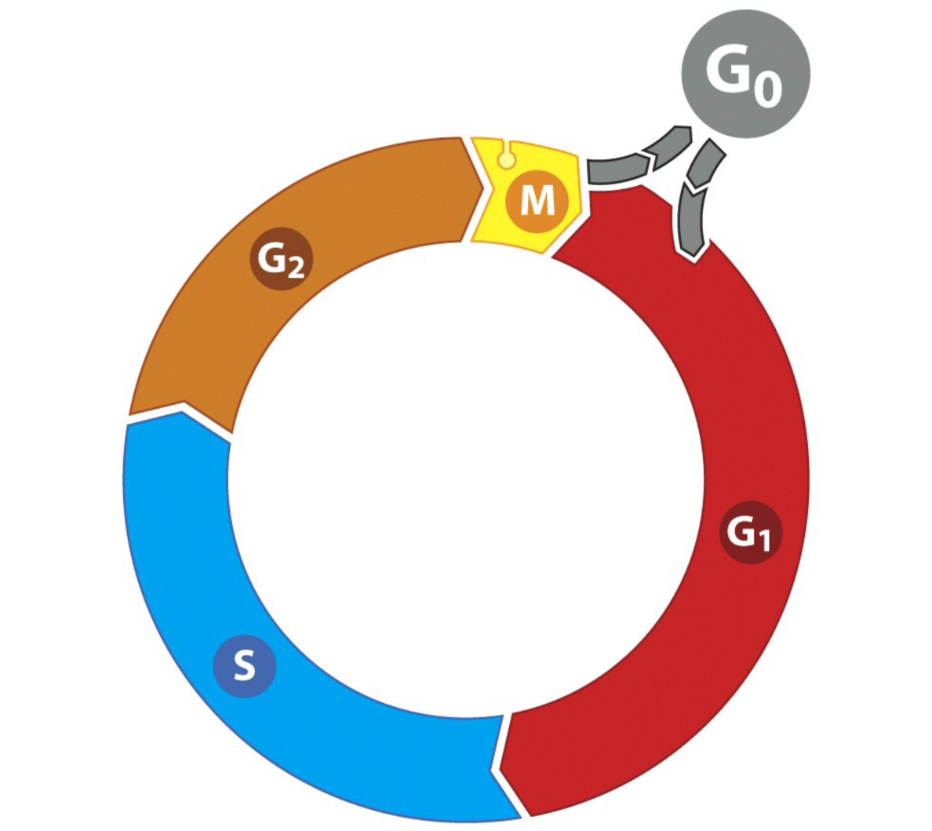
The clock has different phases
Starting point
Not dividing
Prepare to divide
What kind of external signals
are around?
Duplicate
Chromosomes

Slide 7
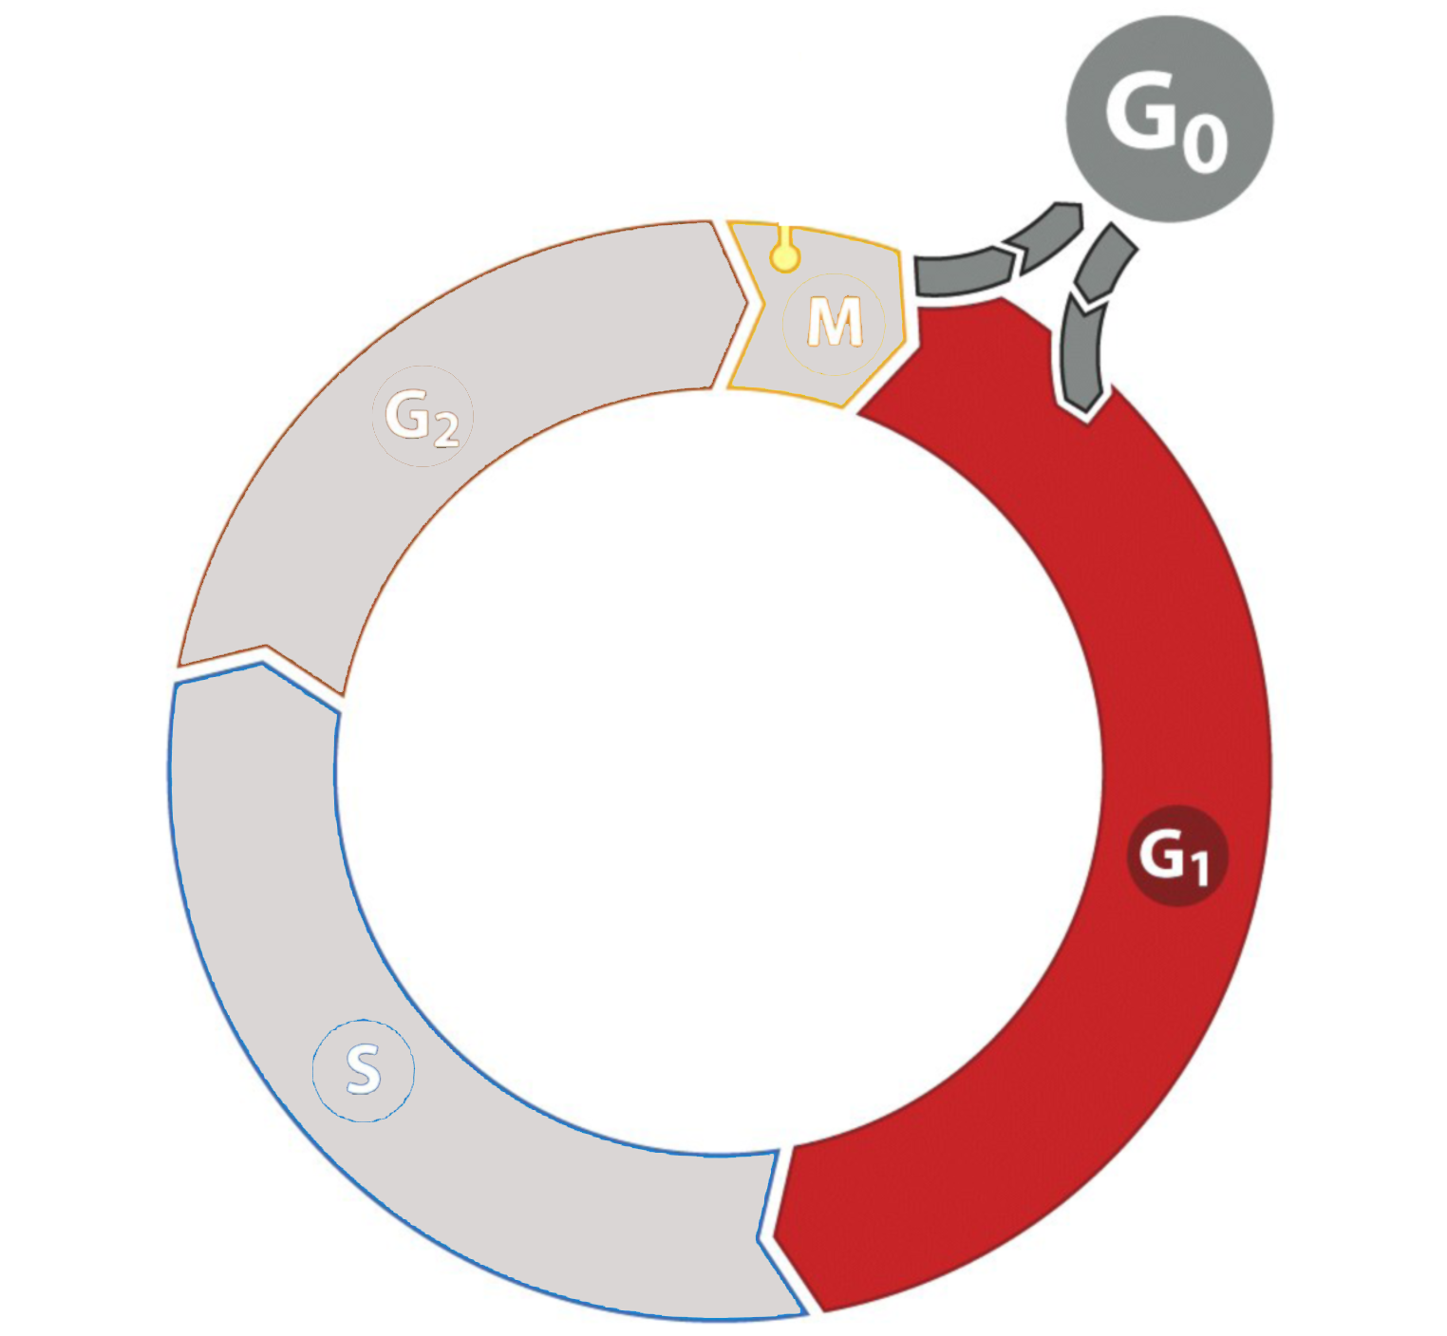
The G₁ (GAP 1) phase
G1: What signals are around?
Starting point
Decision outcomes:
Advance and divide
Stop dividing altogether
- Go to G₀
Wait around in G₁
Point of no return
(restriction point)
After this point the cell stops listening to outside signals

Slide 8
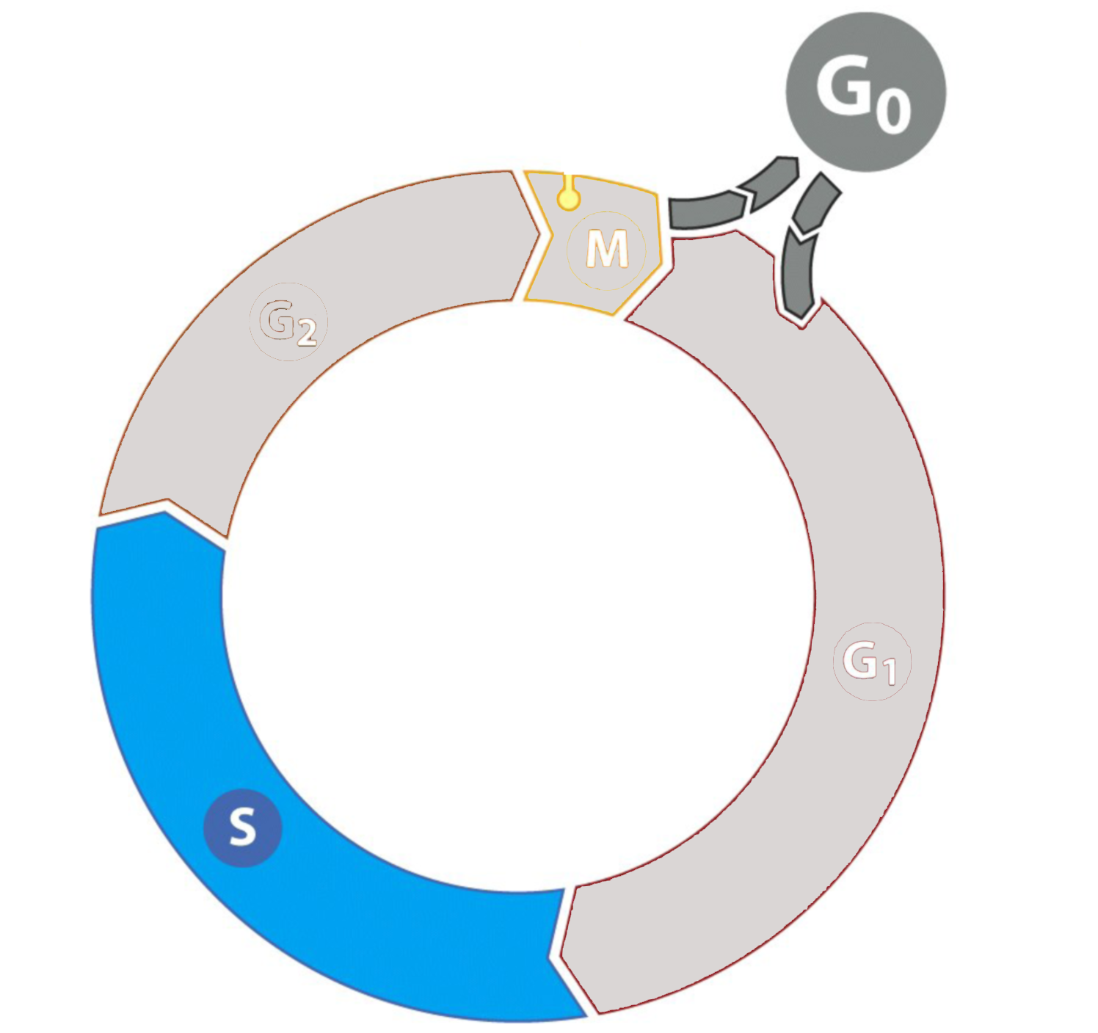
The S (synthesis) phase
Starting point
S: Duplicate chromosomes
Each of the 23 pairs of chromosomes
Duplicates in 6 - 8 hours

Slide 9
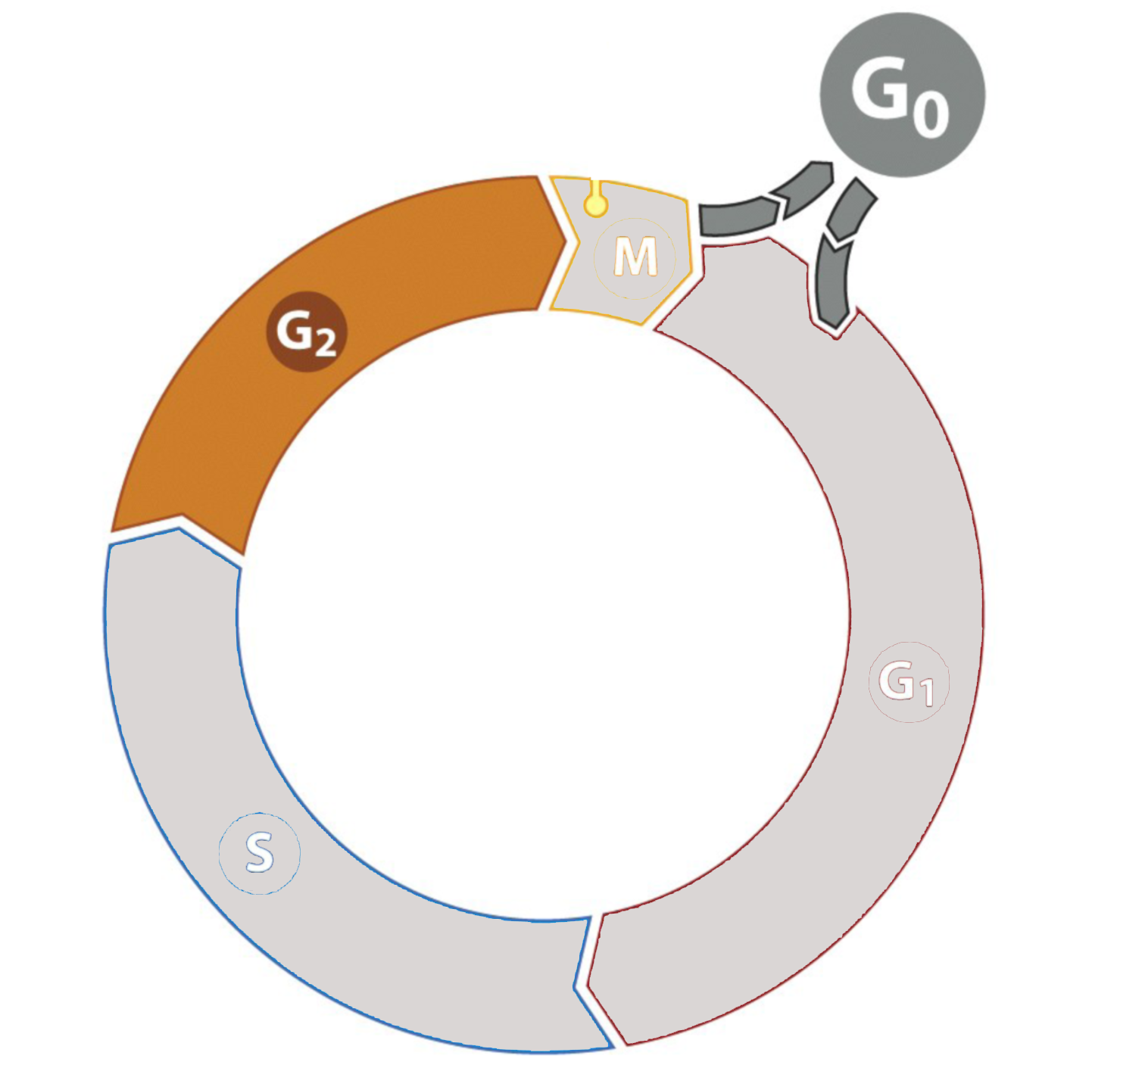
The G2 (GAP 2) phase
Starting point
G2: Prepare for mitosis?
Not known exactly what happens here!
Doesn’t happen in all cells
When it does, it lasts about 4 hours
Notes:
G2 or (GAP 2 phase)
We think the cell is assembling the machinery for cell division in this phase, which takes about 4 hours, but we’re not sure because not all cells have a G2 phase. But it is believed that the remaining proteins necessary for mitosis (that aren’t made in S phase) are made in this phase.
Slide 10

Slide 10
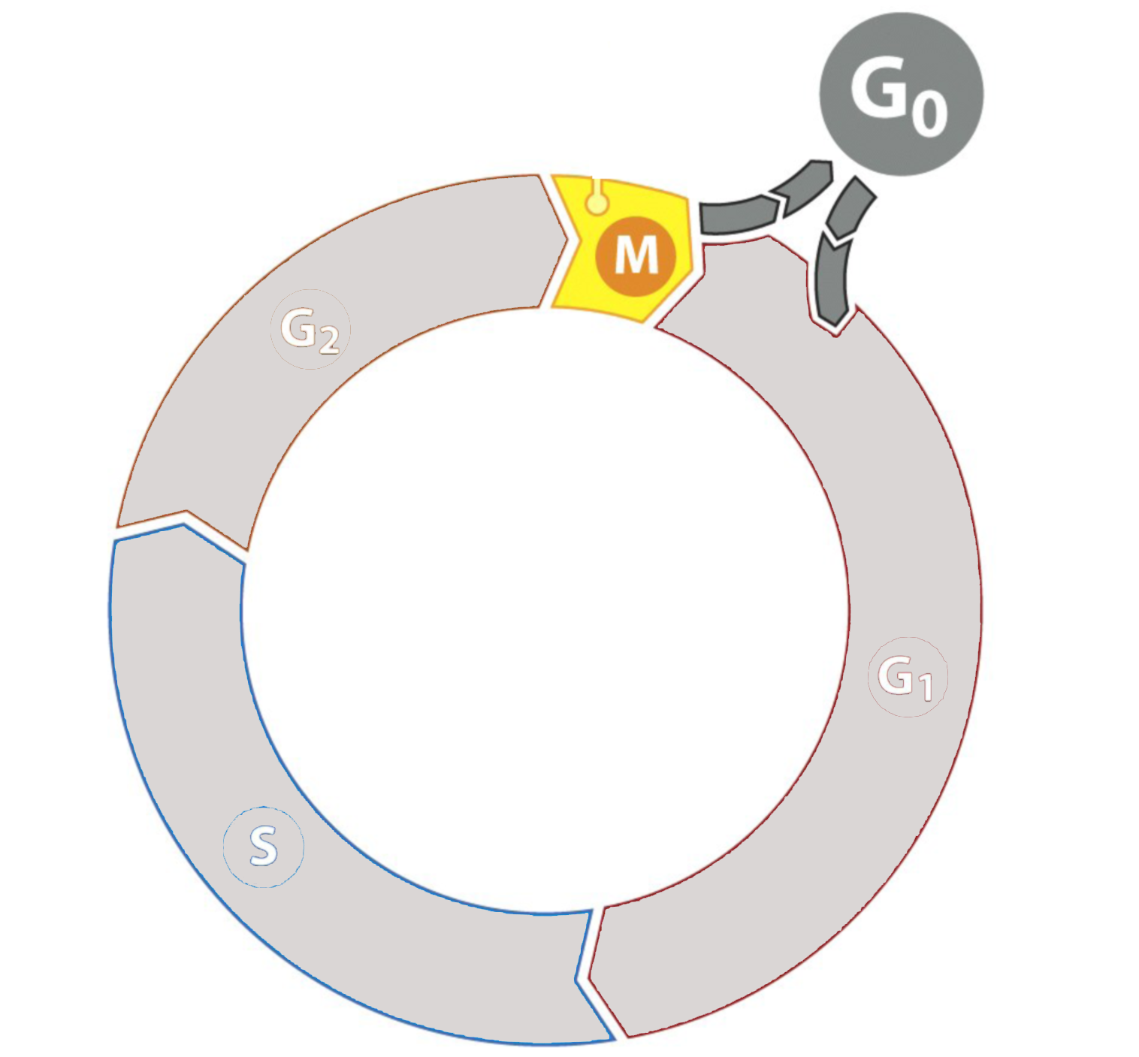
The M (mitosis) phase
Starting point
M: Make two daughter cells and transfer half the chromosomes to each.
Prophase
Metaphase
Anaphase
Telophase
Notes:
Ask students: “What happens during mitosis?”
The cell makes two daughter cells and transfers full set of chromosomes to each.
Students should know the four phases of mitosis, and that their role is to separate the duplicated chromosomes into two daughter cells, but for our purposes its not necessary to memorize each of the phases in detail.

Slide 11
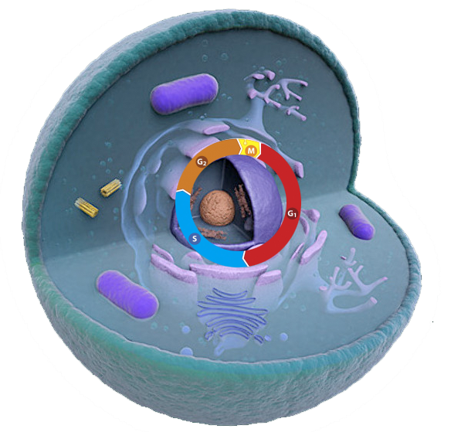
How do cells control progression through the cell cycle?
Divide!!
Don’t divide!!
Drivers
Checkpoints

Slide 12
Each phase of the cell cycle has a driver to move it forward
G₁ Driver

Slide 13
Each phase of the cell cycle has a driver to move it forward
S Driver 2
S Driver 1

Slide 14
Each phase of the cell cycle has a driver to move it forward
G₂/M Driver

Slide 15
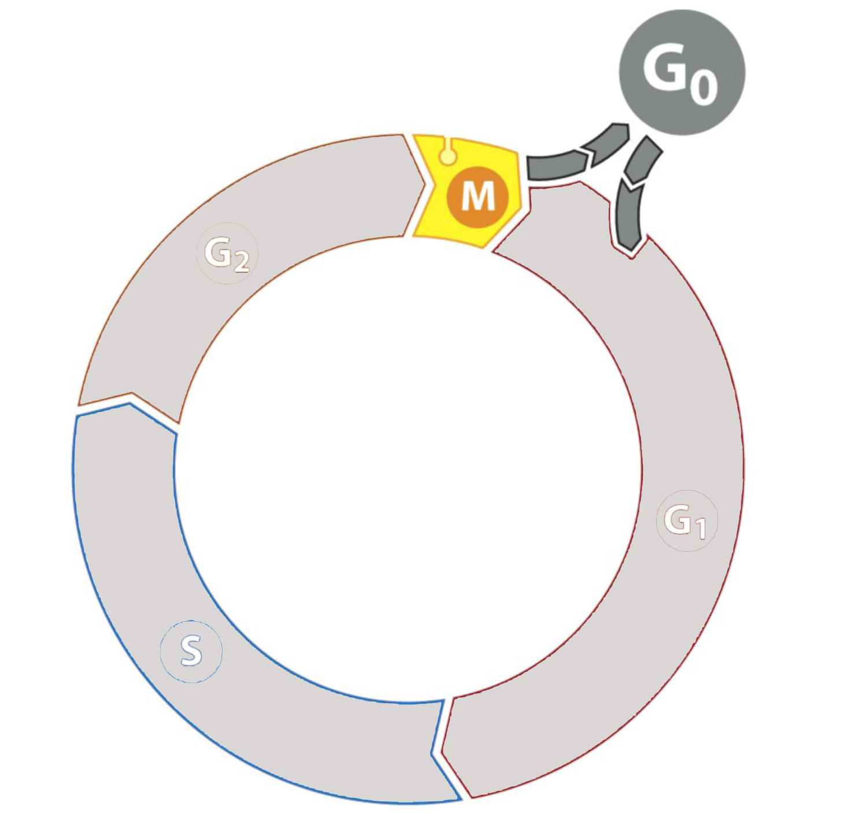
Each phase of the cell cycle has a driver to move it forward
G₂/M Driver

Slide 16
The amount of each driver changes as the cycle proceeds.
G₁ Driver
S Driver 1
S Driver 2
G₂/M Driver
G₁ Driver

Slide 17
Drivers are composed of two proteins
Driver
switch
Cyclin

Slide 18
How do cells control progression through the cell cycle?
Divide!!
Don’t divide!!
Drivers
Checkpoints

Slide 19
There are three cell cycle checkpoints
G₂ Checkpoint
Mitosis Checkpoint
Is my DNA correctly replicated?
Are chromosomes ready for separation?
G₁ Checkpoint/ Restriction Point
Is environment ok?
Is my DNA intact?

Slide 20
Checkpoints regulate the cycle
G₁ Checkpoint/
Restriction Point
Is environment ok? - YES
Is my DNA intact? - YES
Is environment ok?
Is my DNA intact?

Slide 21
Checkpoints regulate the cell cycle
G₂ Checkpoint
Is my DNA correctly replicated?
Is my DNA correctly replicated? - YES
G₁ Checkpoint/ Restriction Point
Is environment ok? - YES
Is my DNA intact? - YES

Slide 22
Checkpoints regulate the cell cycle
Mitosis Checkpoint
G₂ Checkpoint
Are chromosomes ready for separation?
Are chromosomes ready for separation? - YES
Is my DNA correctly replicated? - YES
G₁ Checkpoint/ Restriction Point
Is environment ok? - YES
Is my DNA intact? - YES

Slide 23
How checkpoints can also stop the cycle
Mitosis Checkpoint
G₂ Checkpoint
G₁ Checkpoint/ Restriction Point

Slide 24
How do checkpoints stop the cycle?
Mitosis Checkpoint
G₂ Checkpoint
G₁ Checkpoint/ Restriction Point

Slide 25
Checkpoint proteins inhibit drivers
✖
Mitosis Checkpoint
✖
G₂ Checkpoint
✖
✖
G₁ Checkpoint/ Restriction Point
= Checkpoint Protein

Slide 26
Checkpoint proteins inhibit drivers
✖
✖
✖
G₁ Driver
✖
G₁ Checkpoint/ Restriction Point
Is environment ok? - YES
Is my DNA intact? - YES

Slide 27
Checkpoint proteins inhibit drivers
✖
✖
G₁ Driver

Slide 28
Checkpoint proteins inhibit drivers
✖
✖
S Driver 2
S Driver 1

Slide 29
Checkpoint proteins inhibit drivers
✖
G₂/M Driver
✖
✖
G₂ Checkpoint
Is my DNA correctly replicated? - YES

Slide 30
Checkpoint proteins inhibit drivers
✖
G₂/M Driver
Mitosis Checkpoint
✖
Are chromosomes ready for separation? - YES

Slide 31
Checkpoint proteins inhibit drivers
G₂/M Driver

Slide 32
Checkpoint proteins inhibit drivers
Rb = Retinoblastoma
Prevents cells from passing the point of no return where they no longer pay attention to external signals.
INK proteins
Prevent drivers from promoting cell cycle progression
INKs
INKs
Rb

Slide 33
Activity: Cell Cycle Progression
Work in groups to simulate how signals promote progression through the cell cycle by activating drivers.

Slide 34
Wrap Up: What could go wrong?
How could you cheat to increase the ability of your cell to grow?
Ignore surrounding signals
Have all drivers always active
Get rid of INK/Rb proteins
Uncontrolled growth is called hyperproliferation.
This is what leads to cancer!

Slide 35
How could hyperproliferation occur?
X
Divide!!
Don’t divide!!
Cell receives too much pro-growth (divide) signals
Cell ignores anti-growth (don’t divide) signals

Slide 36
How else can hyperproliferation occur without signals?
DNA Damage
Occurs randomly
Caused by carcinogens
What would happen if a driver or checkpoint protein were mutated?
DNA Damage

Slide 37
Unregulated drivers and checkpoints lose cell cycle control!
G₂/M Driver
G₂/M Driver
G₁ Driver
G₂/M Driver
G₁ Driver
G₁ Driver

Slide 38
Drivers and checkpoints
Drivers are proto-oncogenes
Checkpoints are tumor suppressors

Slide 39
Homework
Read an article about how chemotherapy works to kill hyperproliferating cancer cells.

